Slide 1
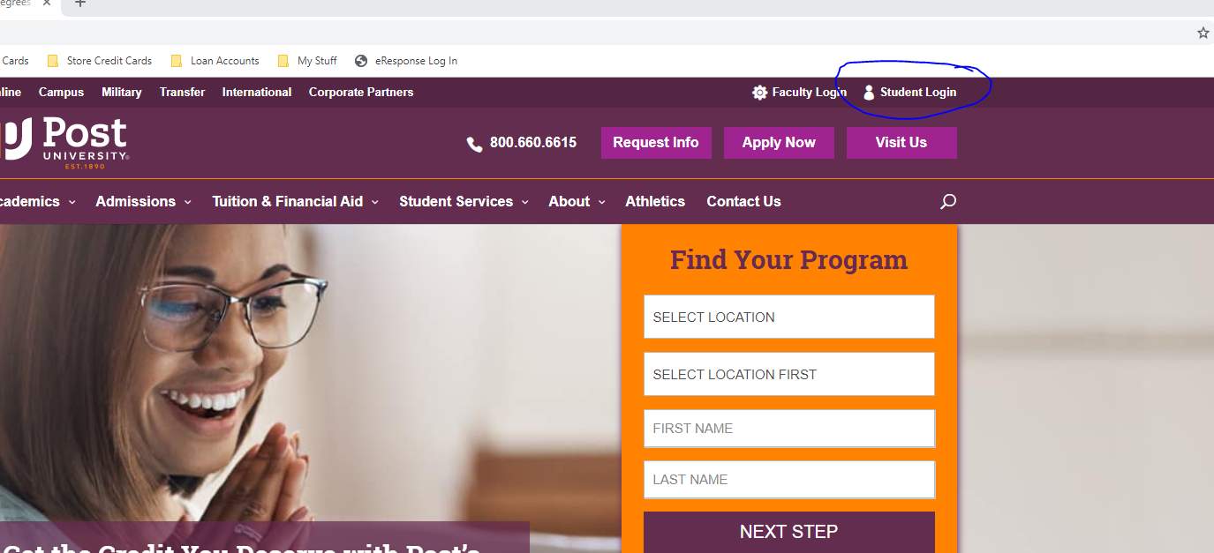
User: Jeffery.perkins@students.post.edu
Logon:corbett68

Slide 2
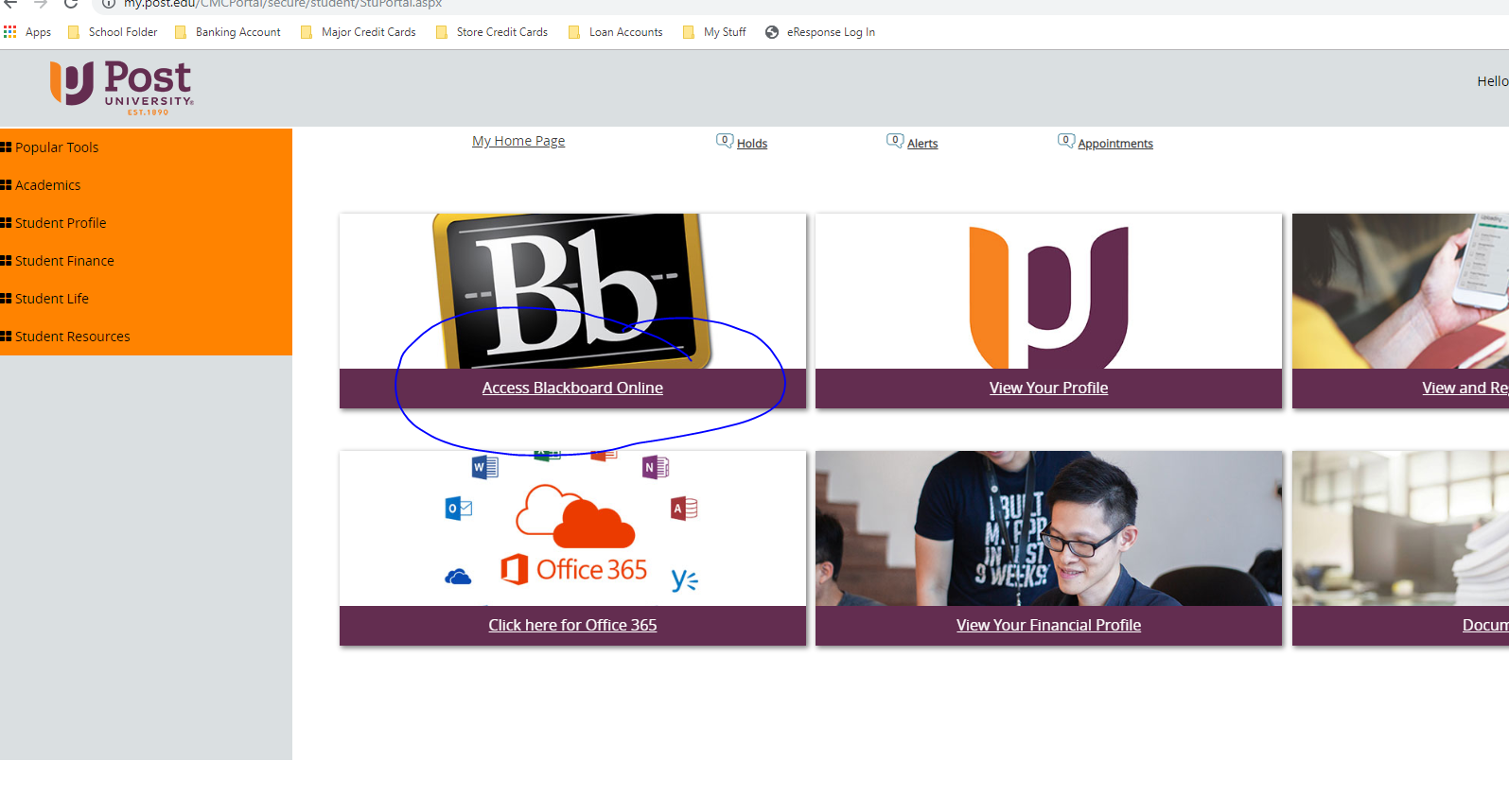

Slide 3
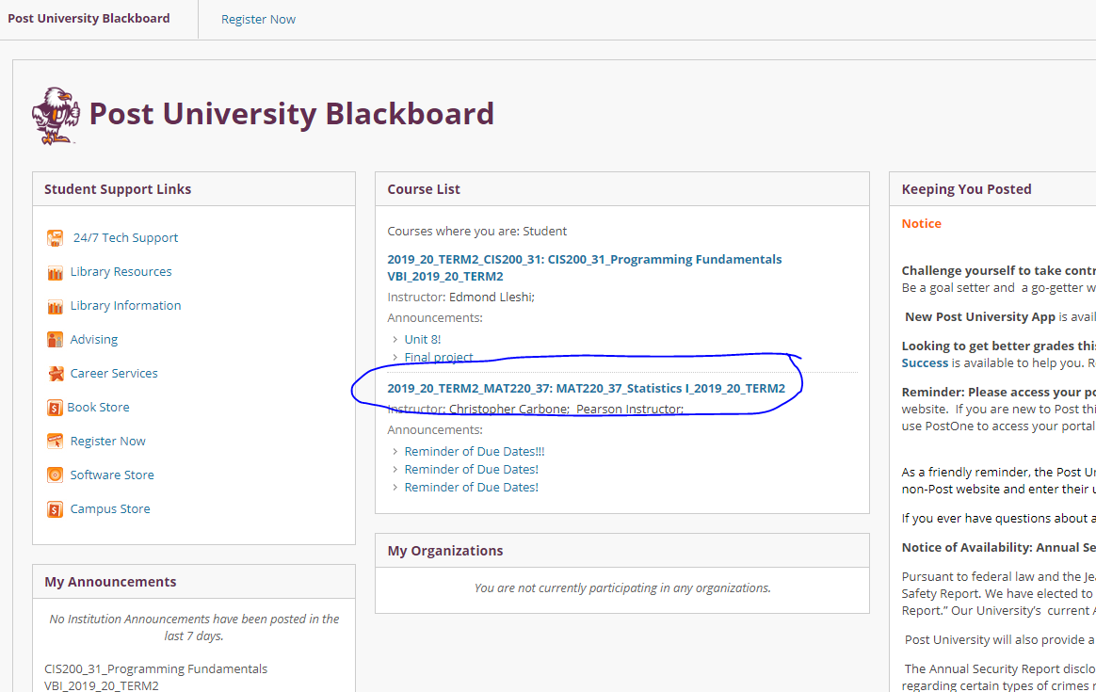

Slide 4
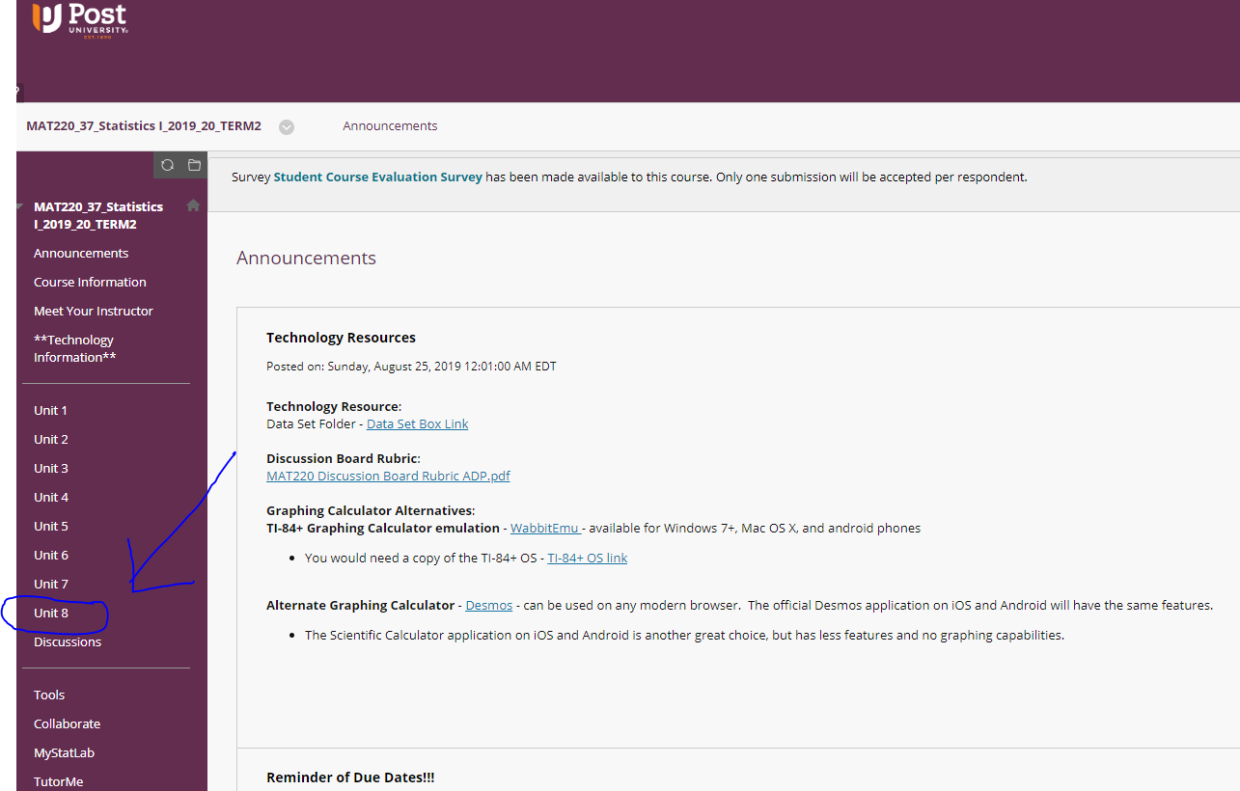

Slide 5
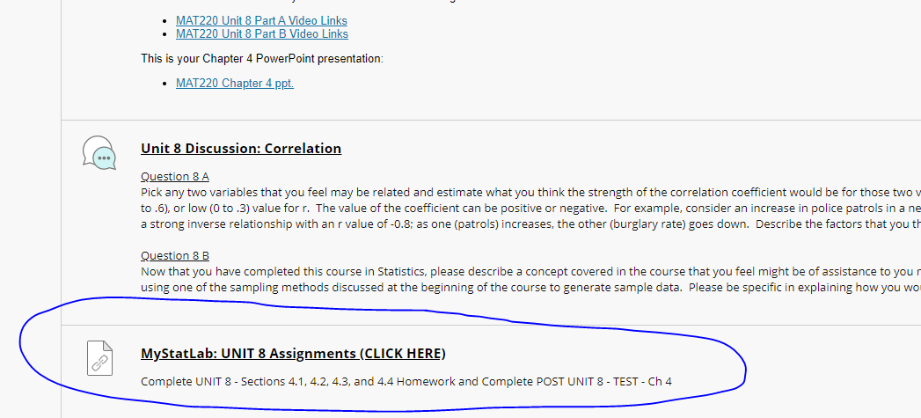
After clicking Unit 8 scroll down to the bottom of the page and you will see what I have circled in blue, and that’s
Where the assignments start they all will have an date of 10/18/2019

Slide 6
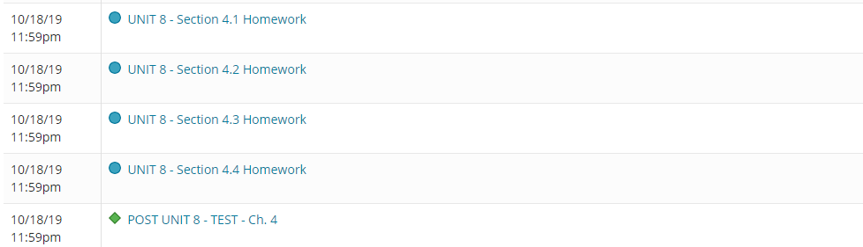
Section 4.1 Homework (8 questions)
Section 4.2 Homework (5 questions)
Section 4.3 Homework (5 questions)
Section 4.4 Homework (5 questions)
Post Test (12 questions)

